Slide 1

Intro to Natural Language Processing in R

Slide 2
Stuff we’re going to talk about…
Tokenization
Document Term Matrices
Keyness
Dictionaries
Embeddings
Transformers

Slide 3
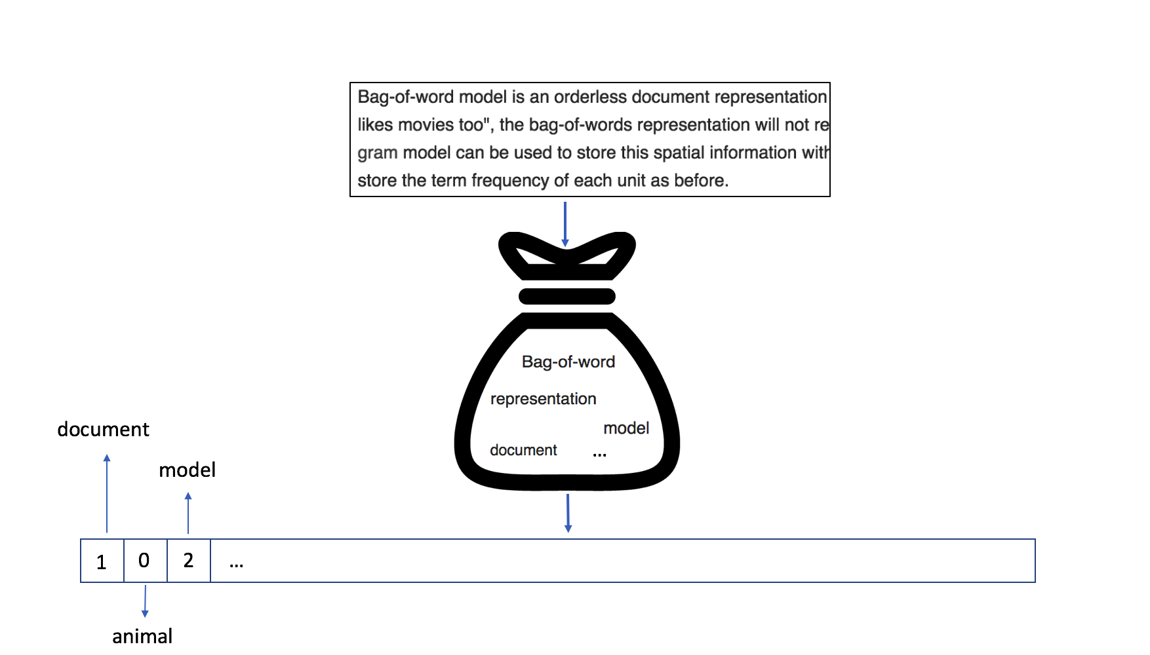
From Text to Matrices
Computational analysis of linguistic data, requires “translating” texts into quantifiable measures
Pre-processing:
(String operations)
Tokenization:
Tokens: {“analysis”, “linguistic”, “data”, “,”, “requires”}
Stems: {“analysi”, “linguist”, “data”, “,”, “requir”}
Lemmas: {“analysis”, “linguistic”, “datum”, “,”, “require”}
Document Feature Matrix (DFM / or DTM)

Slide 4
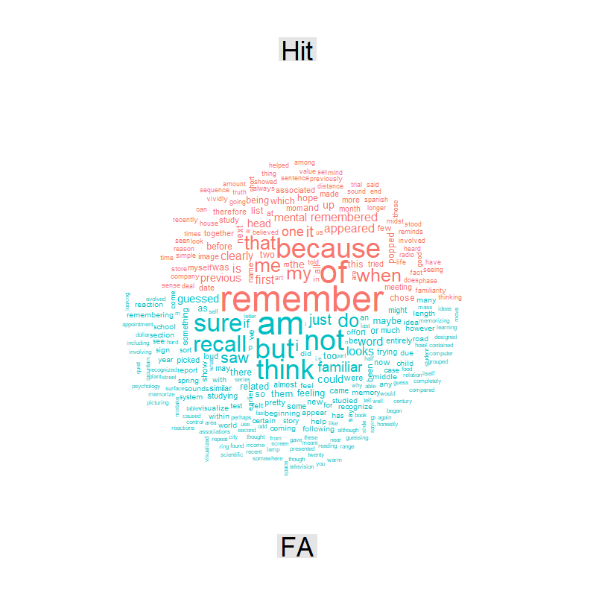
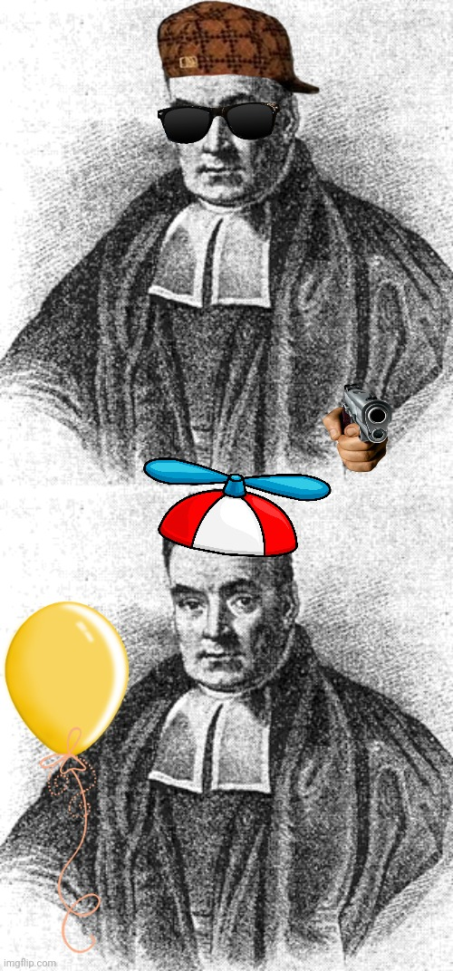
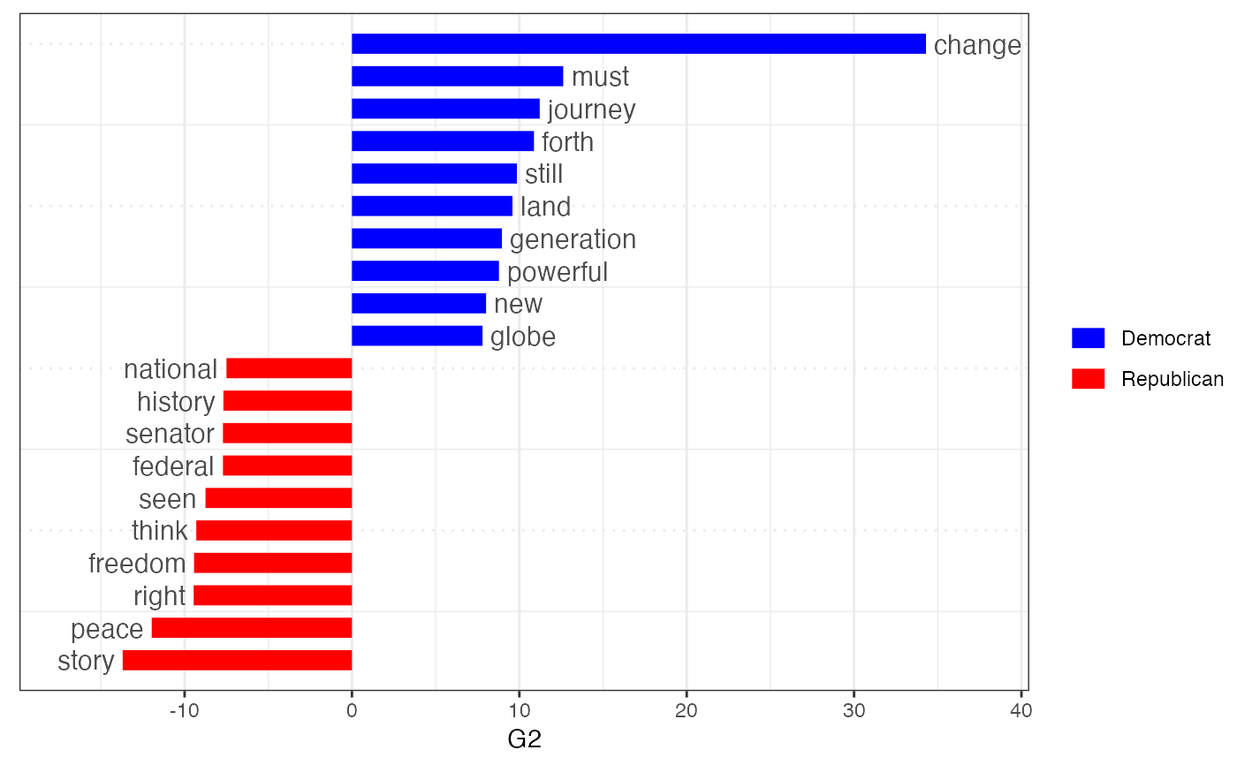
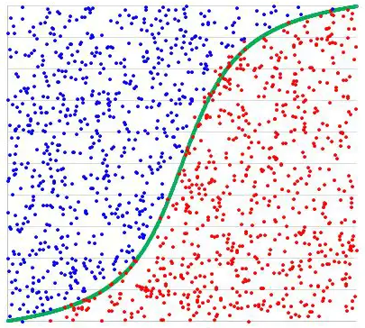
DFMs to…?
Models
Visualization
Keyness – identifying keywords
Dictionaries
…

Slide 5
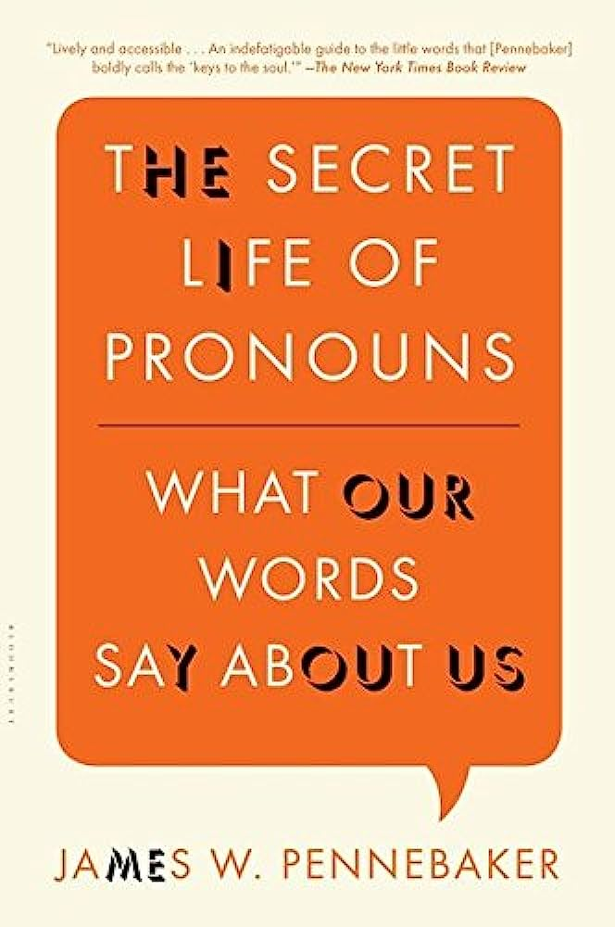
Dictionaries
Simple counts:
Linguistic Inquiry & Word-Count (LIWC; Pennebaker 2011, Tausczik & Pennebaker 2010, Boyd et al., 2022)
NRC Emotion lexicon (Mohammad & Turney, 2010; 2013)
Weighted counts (“Norm Dictionaries”):
Concreteness Ratings (Brysbaert et al., 2014)
Mentalizing Norms (Orr & Gilead 2022)

Slide 6
Let’s StaRt

Slide 7
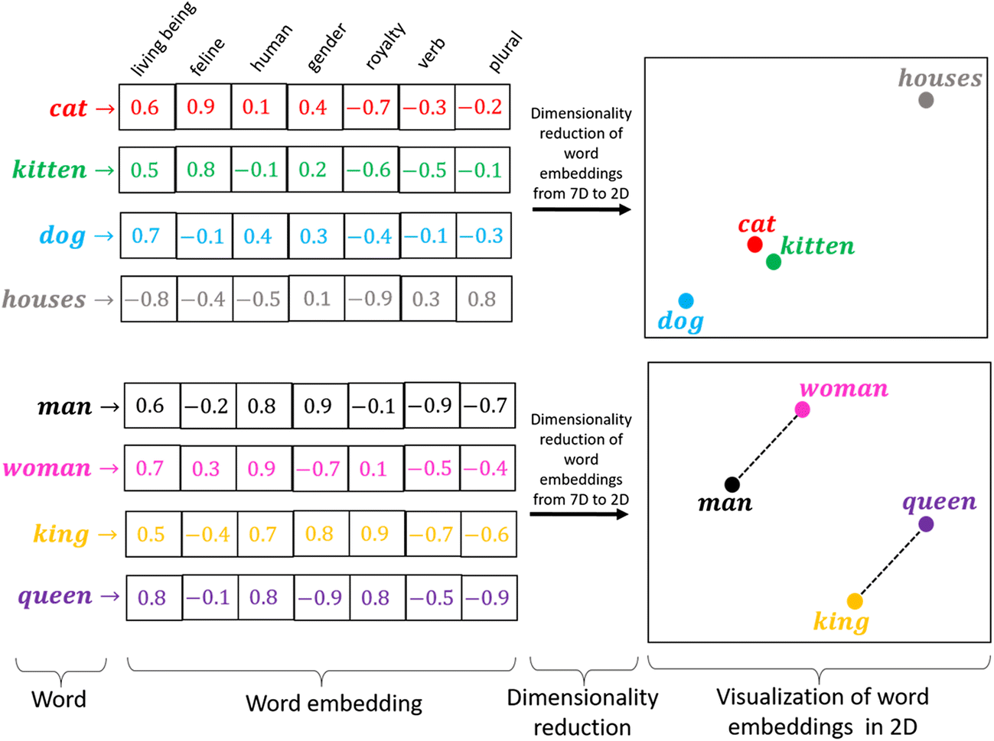
Static Embeddings
Input Corpus and study word co-locates
In practice – choose from existing models:
Word2Vec
gloVe
FastText
A Vector representation per word
Vector arithmetic representing semantics:
Cosine similarity
Word analogues

Slide 8


Embeddings – some extra cool stuff
History of semantics:
See meanings shift between different decades (Hamilton et al., 2016)
Embeddings reflect cultural bias: (Bolukbasi, et al., 2016)
Ask “father : doctor :: mother : x”
x = nurse
Using embeddings for finding nuances
https://avi-g.shinyapps.io/nuance-saurus/

Slide 9
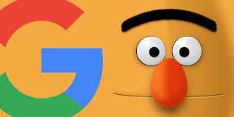

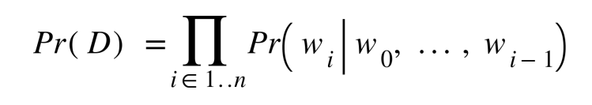
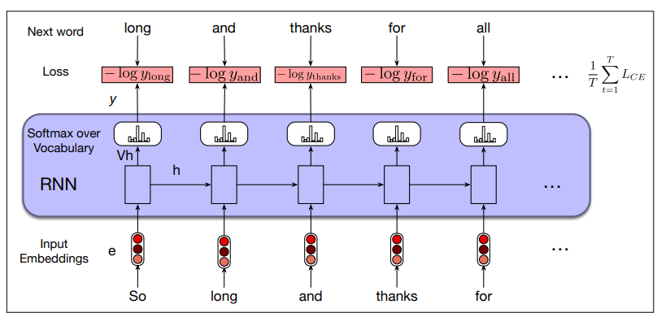
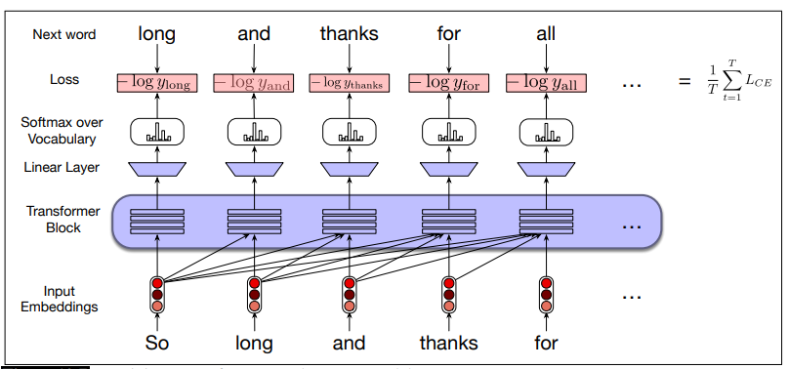
Contextual Embeddings
Neural networks:
Recurrent Neural Networks (RNNs)
Transformers – BERT (Devlin et al., 2018), GPT (Radford et al., 2018)
Language Models:
Given a string of words which word comes next? (Next-word prediction)
Pre-training + Fine-tuning
Embeddings are now set in a specific context
CLS token – the “tofu” soaking up all the context flavors

Slide 10
Back to woRk

Slide 11
Extras
Stanford Speech and Language Processing (SLP) - 3rd Edition
LIWC Narrative Arc
Scraping tweets from twitter with {twitteR}
Sentiment analysis in R with {TATE}
R {text} – fine-tuning transformers in R
Psychological distance (CLT) in texts
AlephBERT – a Hebrew BERT model from BIU-NLP lab
Tutorial on fine-tuning distilBERT for classification

Slide 12
References
Bolukbasi, T., Chang, K. W., Zou, J. Y., Saligrama, V., & Kalai, A. T. (2016). Man is to computer programmer as woman is to homemaker? debiasing word embeddings. Advances in neural information processing systems, 29.
Boyd, R. L., Ashokkumar, A., Seraj, S., & Pennebaker, J. W. (2022). The development and psychometric properties of LIWC-22. Austin, TX: University of Texas at Austin, 1-47.
Brysbaert, M., Warriner, A. B., & Kuperman, V. (2014). Concreteness ratings for 40 thousand generally known English word lemmas. Behavior research methods, 46, 904-911.
Devlin, J., Chang, M. W., Lee, K., & Toutanova, K. (2018). Bert: Pre-training of deep bidirectional transformers for language understanding. arXiv preprint arXiv:1810.04805.
Hamilton, W. L., Leskovec, J., & Jurafsky, D. (2016). Diachronic word embeddings reveal statistical laws of semantic change. arXiv preprint arXiv:1605.09096.
Mohammad, S., & Turney, P. (2010). Emotions evoked by common words and phrases: Using mechanical turk to create an emotion lexicon. In Proceedings of the NAACL HLT 2010 workshop on computational approaches to analysis and generation of emotion in text (pp. 26-34).
Mohammad, S. M., & Turney, P. D. (2013). Crowdsourcing a word–emotion association lexicon. Computational intelligence, 29(3), 436-465.
Orr, R. I., & Gilead, M. (2022). Development and validation of the Mental-Physical Verb Norms (MPVN): A text analysis measure of mental state attribution. Behavior Research Methods, 1-21.
Pennebaker, J. W. (2011). The secret life of pronouns. New Scientist, 211(2828), 42-45.
Radford, A., Narasimhan, K., Salimans, T., & Sutskever, I. (2018). Improving language understanding with unsupervised learning.
Tausczik, Y. R., & Pennebaker, J. W. (2010). The psychological meaning of words: LIWC and computerized text analysis methods. Journal of language and social psychology, 29(1), 24-54.

